Slide 1
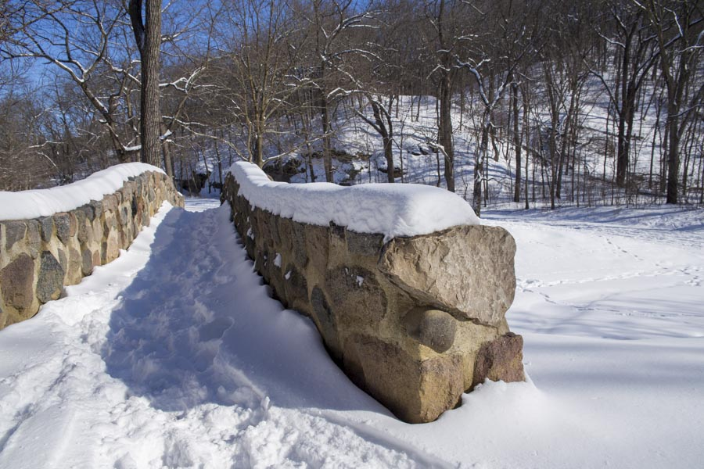
Welcome to

Slide 2
Scripture
Revelation 2:1-7
Look for our event!

Slide 3
Your First Love
02/11/2024

Slide 4
I. Who Christ Is For the Church
A. Christ is Sovereign Over the Church - Vs. 1
B. Christ is Present With the Church - Vs. 1-2

Slide 5
II. What Christ Expects From the Church
A. Faithful Perseverance - Vs. 2-3
B. Wise Discernment - Vs. 2, 6
I Thessalonians 5:21-22 -
Test everything; hold fast what is good. Abstain from every form of evil.

Slide 6
“Parents, along with health care and educational professionals, who support the transgender ‘transition’ of children and adolescents are, in fact contributing to increased depression by appearing to validate to the children that ‘something is wrong with their biological sex…Therefore, the ACPeds cannot condone the social affirmation, medical intervention, or surgical mutilation of children and adolescents identifying as transgender or gender nonconforming.”
~“Mental Health in Adolescents with Incongruence of Gender Identity and Biological Sex,” American College of Pediatricians, 2/24

Slide 7
II. What Christ Expects From the Church
C. Steadfast Love - Vs. 4
II Corinthians 11:2-3 -
I feel a divine jealousy for you, since I betrothed you to one husband, to present you as a pure virgin to Christ. But I am afraid that as the serpent deceived Eve by his cunning, your thoughts will be led astray from a sincere and pure devotion to Christ.

Slide 8
II. What Christ Expects From the Church
C. Steadfast Love - Vs. 4
I Corinthians 13:1-3 -
If I speak in the tongues of men and of angels, but have not love, I am a noisy gong or a clanging cymbal. And if I have prophetic powers, and understand all mysteries and all knowledge, and if I have all faith, so as to remove mountains, but have not love, I am nothing. If I give away all I have, and if I deliver up my body to be burned, but have not love, I gain nothing.

Slide 9
III. Christ’s Retribution Or Reward to the Church
A. Repent or I Remove the Lampstand - Vs. 5
B. Conquer and Feast in Paradise - Vs. 7

